Slide 1


Wind Farm Project Development, WiSe 2024/25
Team 3: Wind Farm Project in Gujarat, India
Presented by: Matriculation No.
Mozafary Mostafa 750247
Patil Rahul 750532
Soni Karan 760153
Guided by: Dr. Marina Blohm
Date : 15.01.2025
Place: Flensburg

Slide 2
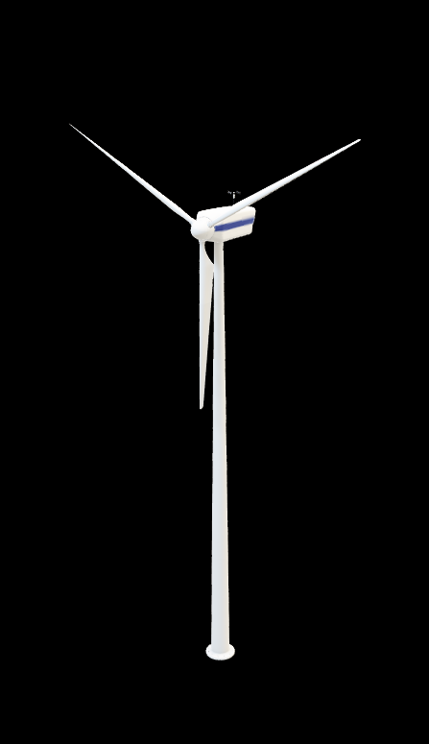
Overview
Overview of wind farm development in Gujarat
Guidelines and Regulations
Project development timeline
Wind Area selection
Grid infrastructure and cable routing
Strategies community engagement
Land Leasing
Addressing conflicting Interests
10. Logistics and Transformation
11. Profitability Analysis
12. Results
13. Long Term Strategy
14. Barriers and Obstacles
15. Conclusion
16. References

Slide 3
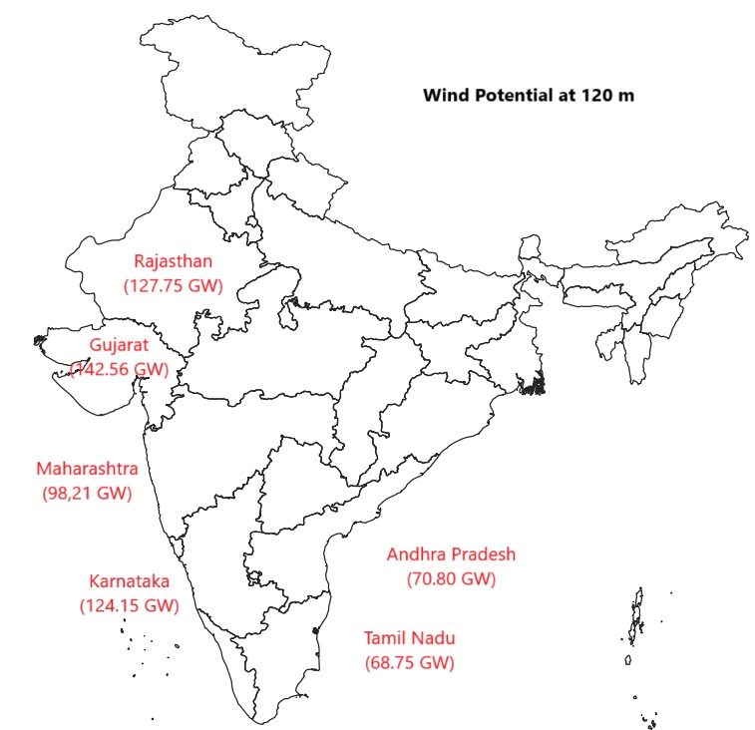
1. Overview of Wind Farm Development in Gujarat
India:
India ranks fourth in terms of installed wind power capacity.
Several Large Wind Farm: Tamil Nadu, Gujarat, Maharashtra.
Gujarat:
As May 2024, makes it the leading state in India for wind energy.
11,823 MW installed wind power capacity
Second rank, Tamil Nadu 10,743 MW
Why?
Geographic advantages, Government supports, Land policy, Tax benefits.

Slide 4
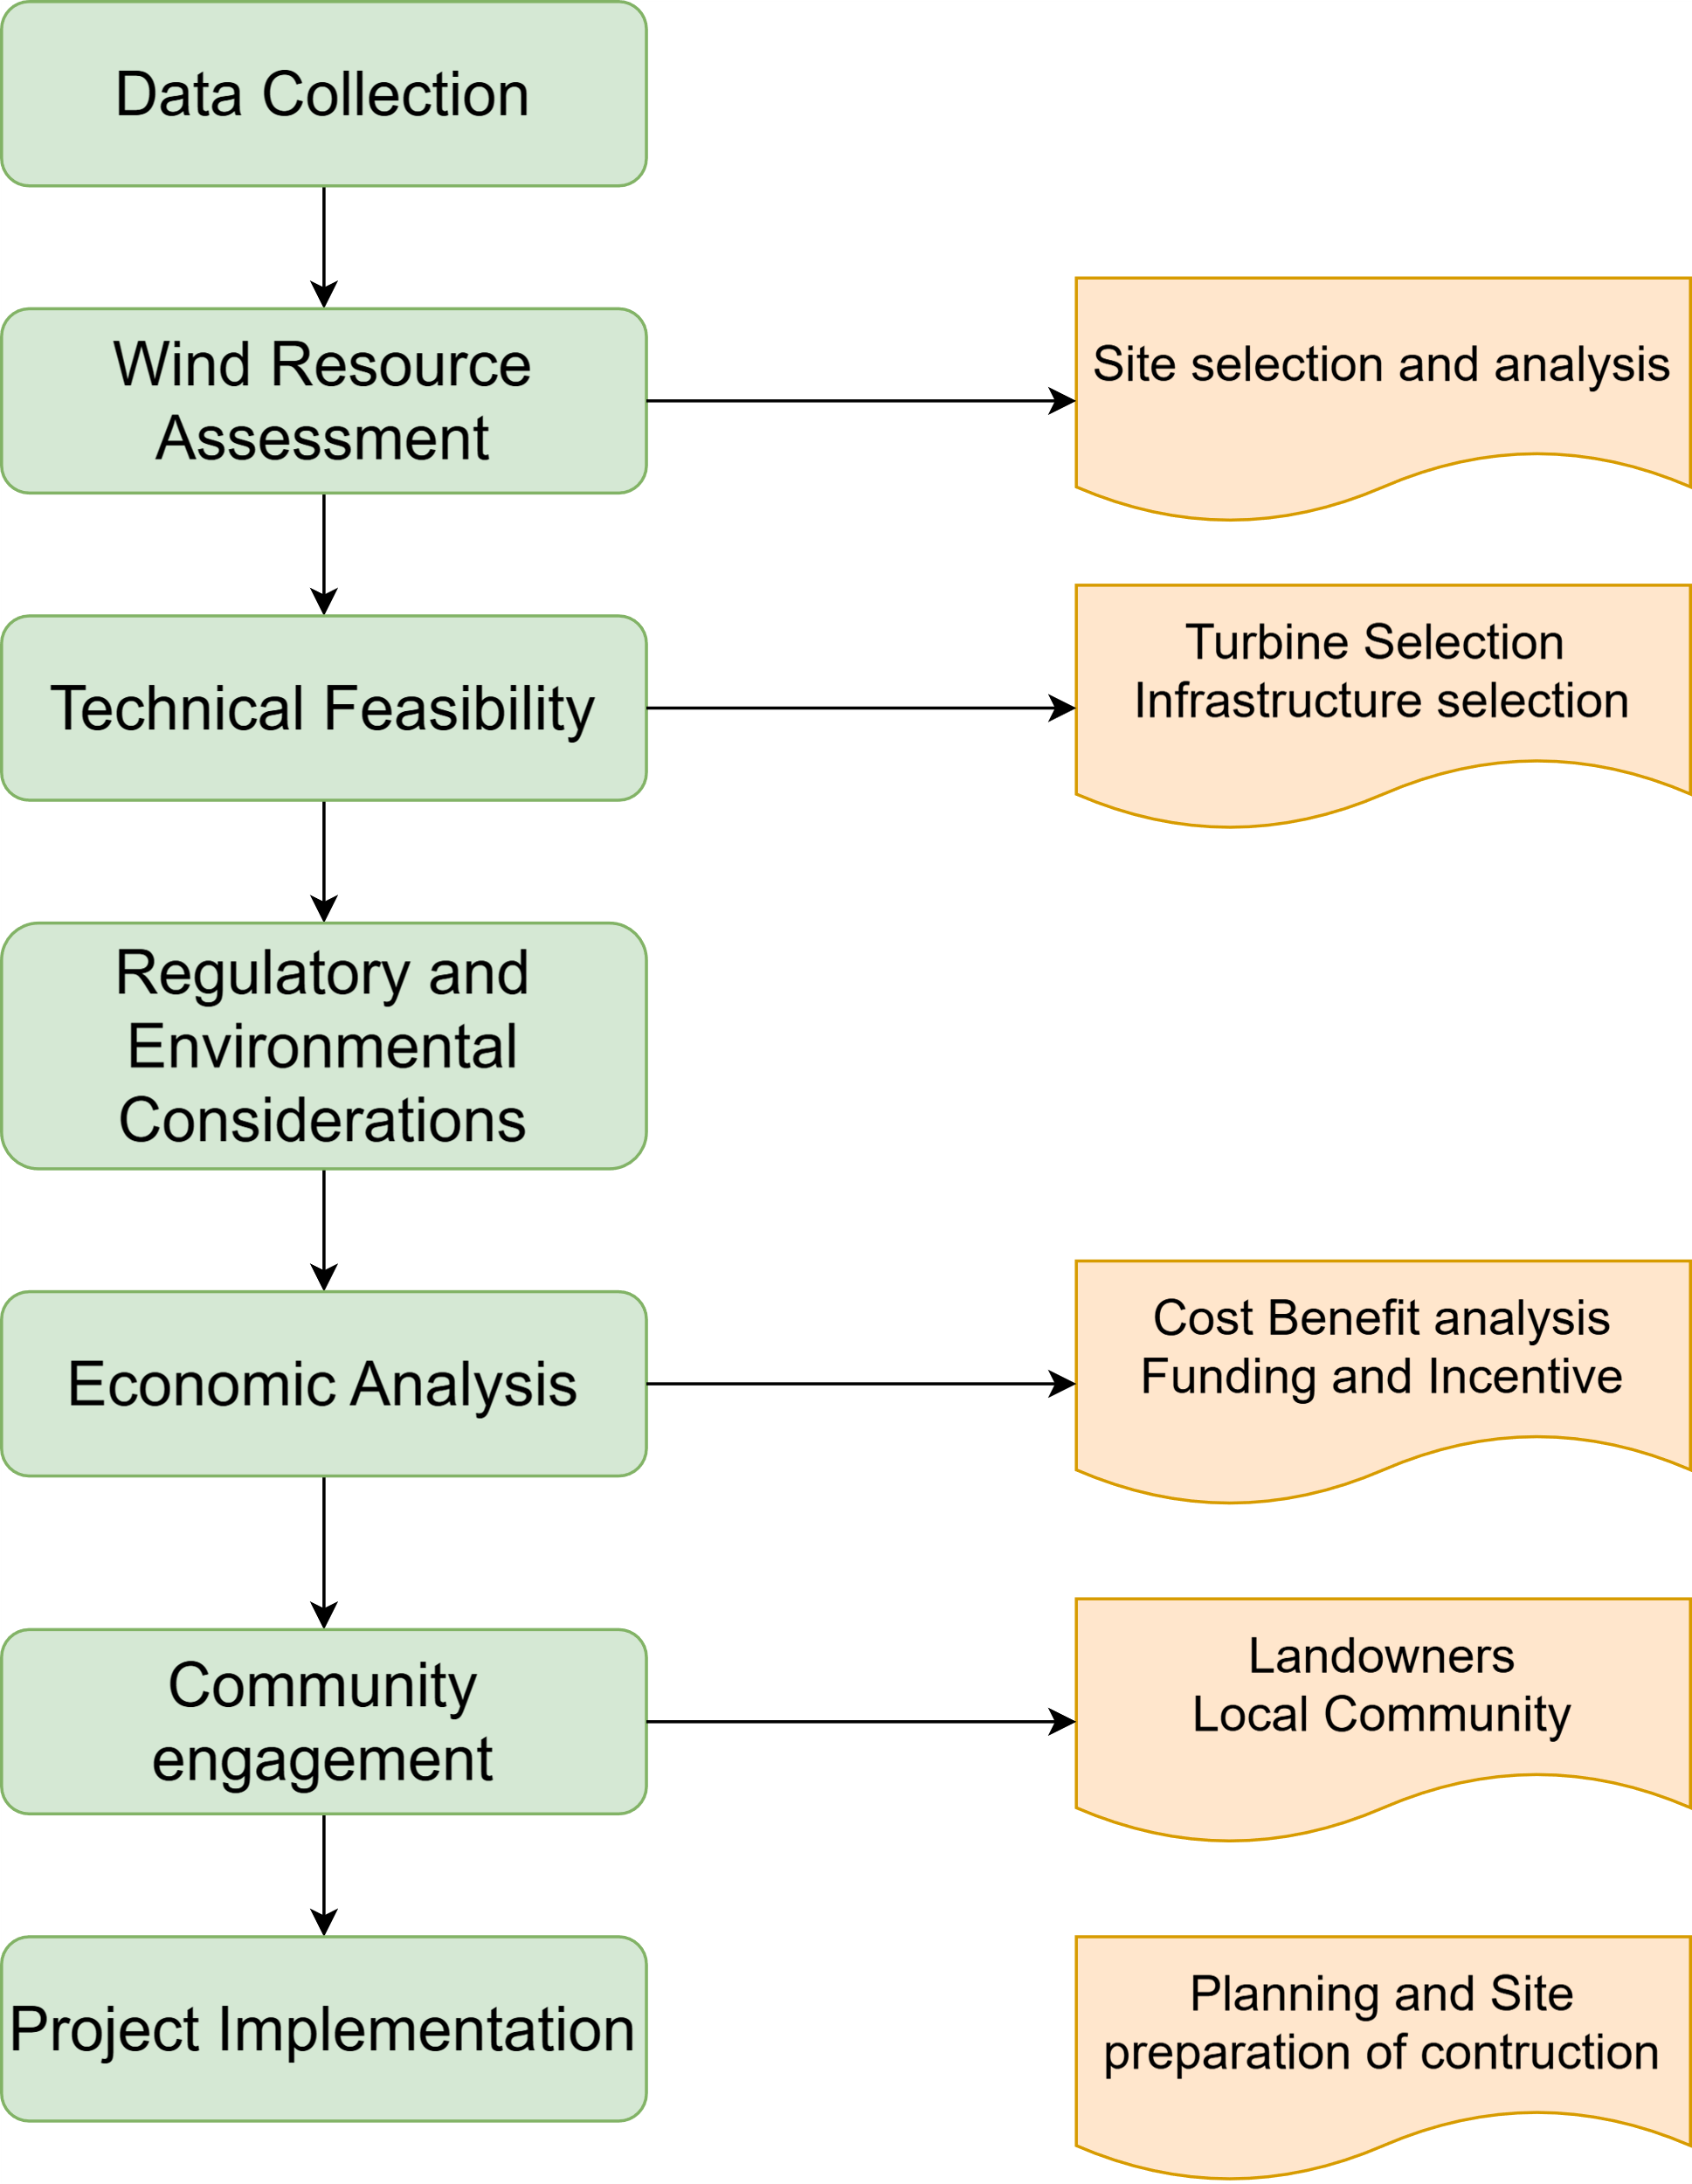
2. Methodology

Slide 5
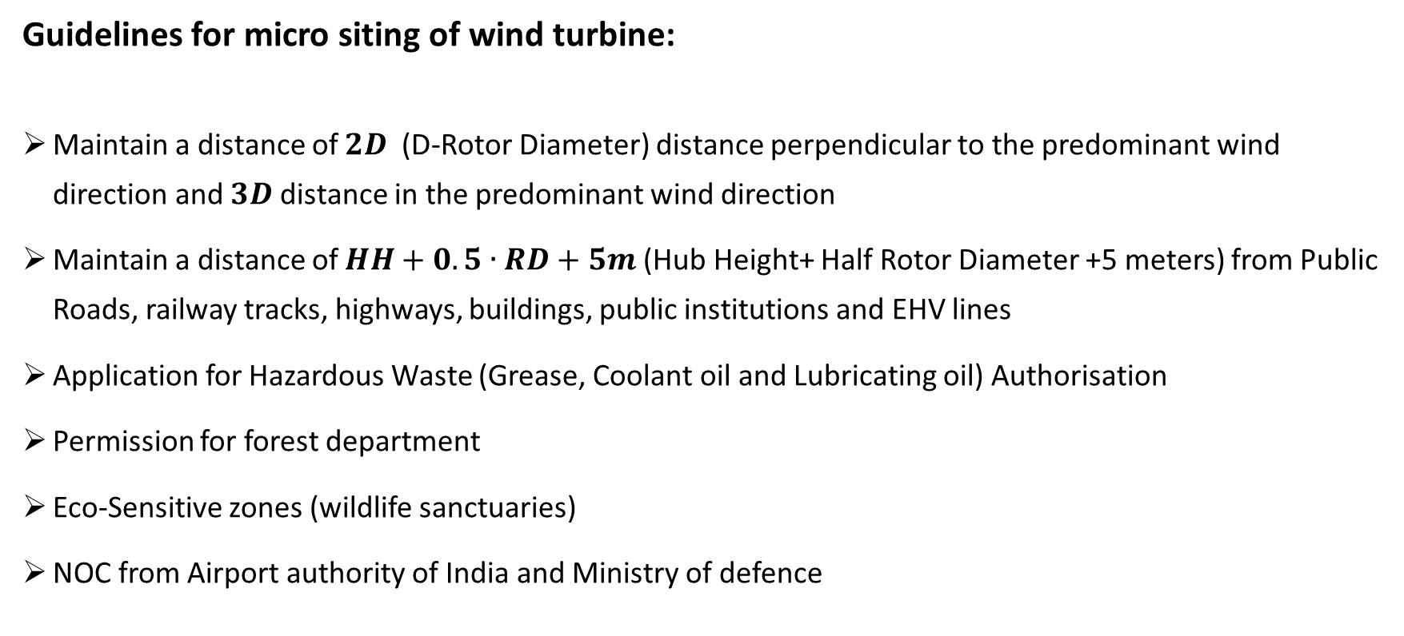
3. Guidelines and Regulations
Guidelines for micro siting of wind turbine:
Maintain a distance of $2D$(D-Rotor Diameter) distance perpendicular to the predominant wind direction and $3D$ distance in the predominant wind direction
Maintain a distance of $HH+0.5∙RD+5m$(Hub Height+ Half Rotor Diameter +5 meters) from Public Roads, railway tracks, highways, buildings, public institutions and EHV lines
Application for Hazardous Waste (Grease, Coolant oil and Lubricating oil) Authorisation
Permission for forest department
Eco-Sensitive zones (wildlife sanctuaries)
NOC from Airport authority of India and Ministry of defence

Slide 6
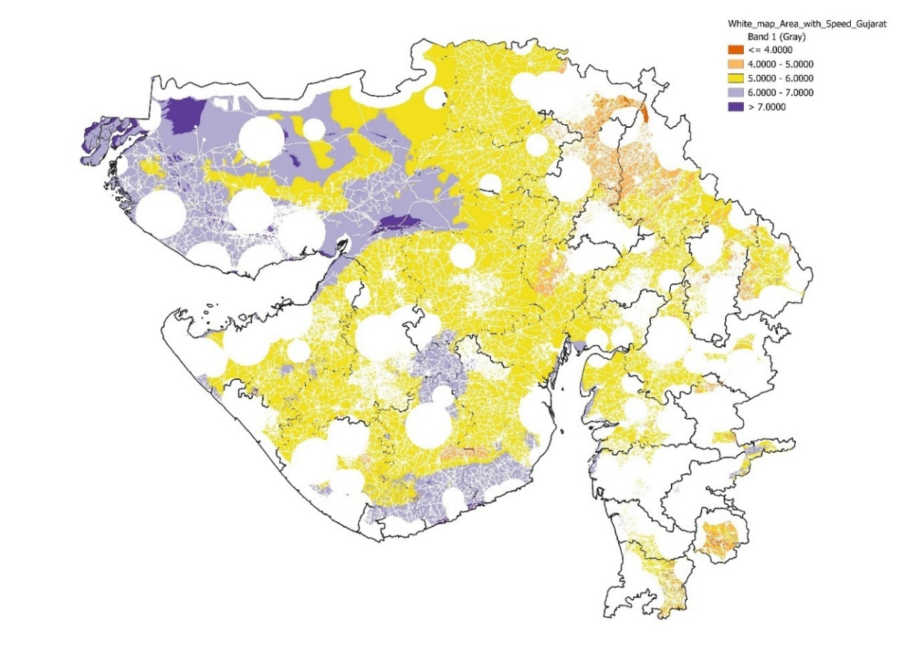
4. Wind Area Selection
Analyse Wind Farm:
Wind speed data at 100m height
Coordinate Reference System: WGS 84/ UTM zone 43N, Authority ID: EPSG:32643
Integrated wind speed data onto the white map layer [Use the clip Raster by Mask Layer Tool]
GIS Layers | Distances [m]
Buildings | 250
Forests | 10,000
Military Areas | 10,000
Railways/ Industrial | 250
Roads | 250
Airports/ Airfields | 20,000
Rivers | 250

Slide 7
6. Project Development Timeline

Slide 8
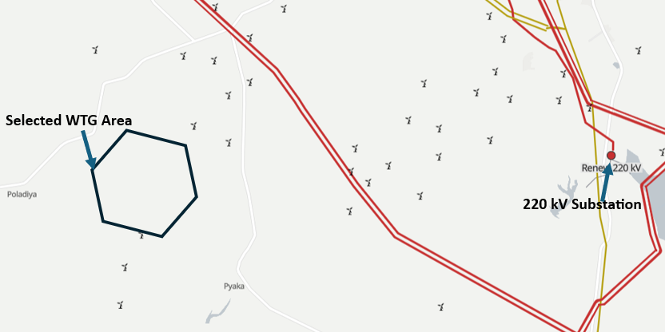
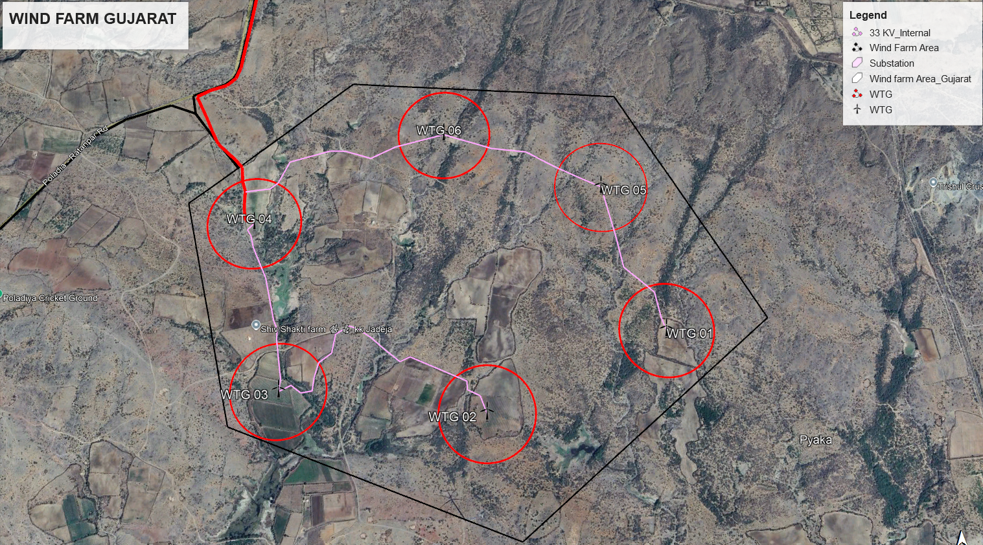
4. Wind Area Selection
Used Google Earth Pro for a comprehensive site assessment

Slide 9
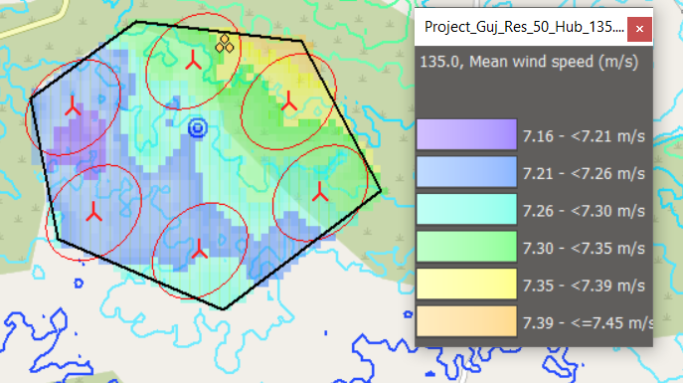
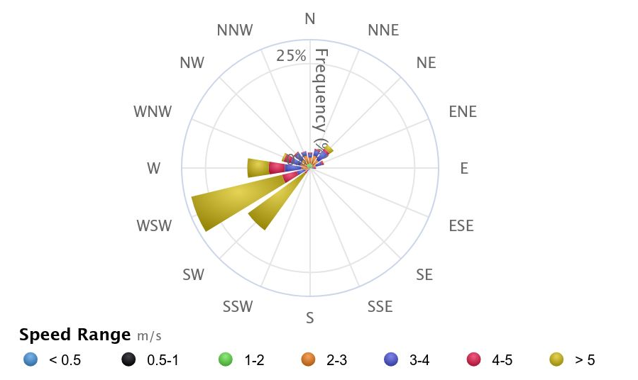
4. Wind Area Selection
Six Suzlon 2.1 MW wind turbines, strategically positioning them to account for wind direction

Slide 10
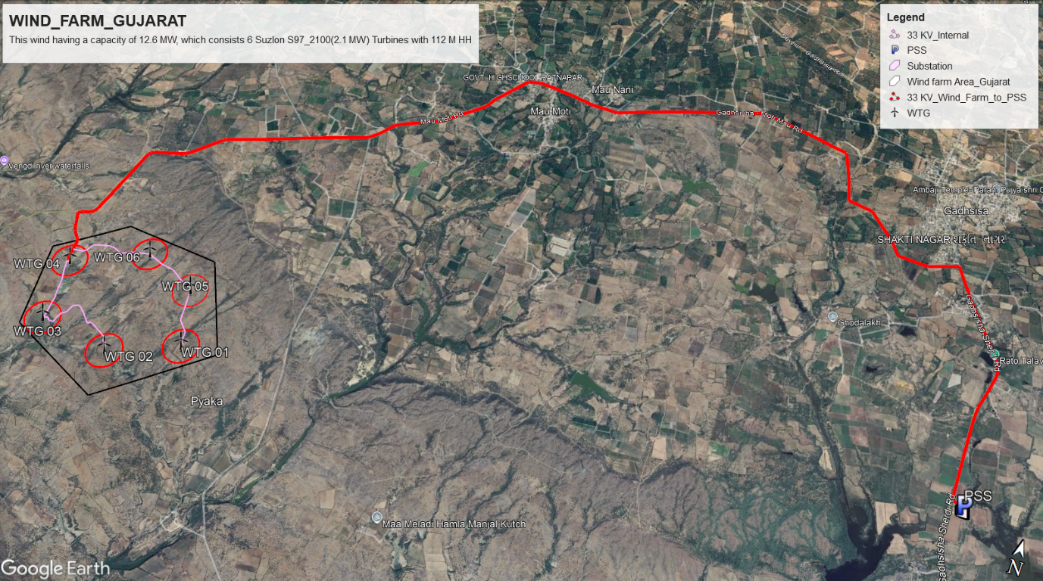
5. Grid Infrastructure and Cable Routing
Our wind farm has a capacity of 12.6 MW, which is relatively below 20 MW. Therefore, we utilized an available substation.
The substation, named Renew Wind Energy (AP2) Pvt Ltd, operates at 33/220 kV.
The length of the 33 kV line from the wind farm area to the pooling substation is 20 km.

Slide 11

7. Strategies of Community Engagement
Benefits of the Wind Park Project
Job Creation:
1 full-time site manager
2 full-time operators for maintenance and repairs
Profit for Landowners
Addressing Power Outages:
A reliable electricity supply for the village (currently interruptions caused by infrastructure issues, scheduled cuts, or weather conditions.)
Infrastructure Development:
Supports the expansion of rural infrastructure
31th July 2012, the world's biggest blackout [source:nbcnews]

Slide 12
7. Strategies of Community Engagement
Benefit Sharing
Community Meetings: Highlight benefits (jobs, infrastructure, clean energy) and address concerns.
Engage Local Leaders: Gain trust and support from key influencers.
Transparency: Share project details, timelines, and impacts openly.
Benefit Sharing: Provide scholarships, infrastructure upgrades, or community funds.
Regular Updates: Keep everyone informed on progress through consistent communication.
Community Feedback
Long Term Engagement
Community Meeting
Engage Local Leaders
Transparency
Raise Awareness
Regular Updates

Slide 13
8. Land Leasing
Land Leasing Overview:
Secure land for wind park projects under Gujarat’s progressive renewable energy policies.
Lease Duration: 40 years for government fallow land.
Policy Scope: Focus on renewable energy generation to support Gujarat’s industrial and green energy goals.
Eligibility: Companies with experience in renewable energy and sufficient financial capacity.

Slide 14
8. Land Leasing
Eligibility and Allocation:
Eligibility:
Minimum 500 MW renewable energy generation experience.
Net worth: ₹1200 crore/lakh metric tons of energy/year.
Industries requiring 1 lakh metric tons/year of green hydrogen prioritized.
Land Allocation:
Exclusive use for wind energy projects.
Cap of 30 lakh metric tons/year green hydrogen production per entity.
Reserved land for future state requirements.

Slide 15
8. Land Leasing
Application and Approval Process:
Application Submission:
Preliminary preparation report (technical and financial).
Verification:
Nodal Agency (GPCL) validates eligibility and technical aspects.
Review & Recommendation:
High Power Committee (HPC) evaluates proposals.
Final Approval:
Government decision via Revenue Department.
Lease agreement executed with a tripartite agreement.

Slide 16
8. Land Leasing
Responsibilities & Compliance:
Developer Responsibilities:
Infrastructure: Roads, transmission, and water systems.
Financial: ₹180,000 (€ 2050)/ha annual rent (15% increase every 3 years).
Progress Milestones:
50% capacity in 3 years.
100% capacity in 8 years.
Compliance:
Periodic reviews to ensure milestones.
Unused land subject to reclamation.

Slide 17
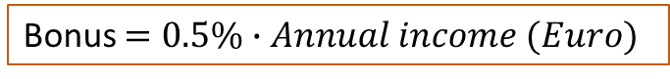
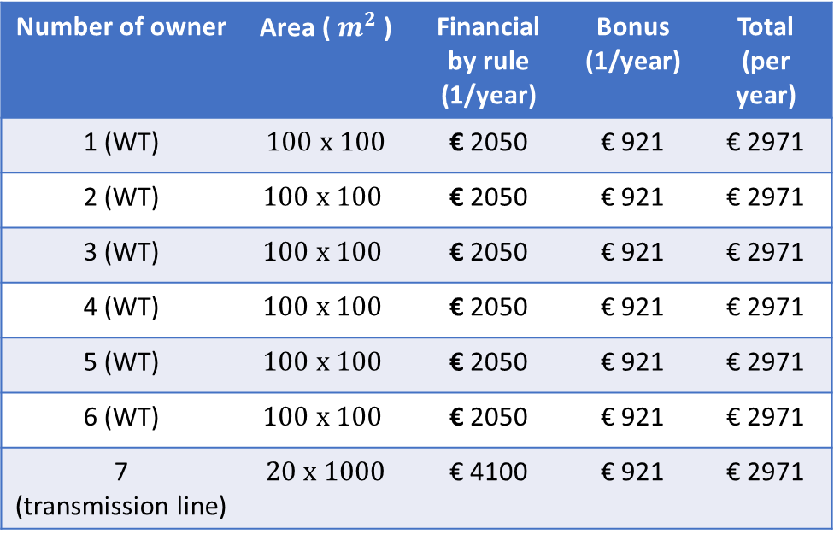
8. Land Leasing
Number of owner | Area ( $m^{2}$ ) | Financial by rule (1/year) | Bonus (1/year) | Total (per year)
1 (WT) | $$100 x 100$$ | € 2050 | € 921 | € 2971
2 (WT) | $$100 x 100$$ | € 2050 | € 921 | € 2971
3 (WT) | $$100 x 100$$ | € 2050 | € 921 | € 2971
4 (WT) | $$100 x 100$$ | € 2050 | € 921 | € 2971
5 (WT) | $$100 x 100$$ | € 2050 | € 921 | € 2971
6 (WT) | $$100 x 100$$ | € 2050 | € 921 | € 2971
7 (transmission line) | $$20 x 1000$$ | € 4100 | € 921 | € 2971
Land Leasing own strategy
Table xx: Land leasing own strategy [own]
Bonus $=0.5\%∙Annual income (Euro)$

Slide 18
9. Addressing Conflicting Interests
Environmental Conflicts in Wind Energy Projects
Land Use Challenges:
Competition over agricultural, forest, and community lands.
Protected areas like the Western Ghats face ecological damage.
Biodiversity Impact:
Bird and bat fatalities due to turbine collisions.
Habitat destruction from road construction and deforestation.
Environmental Trade-offs:
Noise pollution and shadow flicker disturb local communities.
Changes in local hydrology and microclimates from large-scale projects.

Slide 19
9. Addressing Conflicting Interests
Socio-Economic and Governance Conflicts:
Community Livelihood Loss:
Displacement from common lands and inadequate compensation.
Encroachment on tribal lands and loss of natural resources.
Regulatory Gaps:
Lack of stringent Environmental Impact Assessments (EIA).
Unplanned projects ignore landscape-scale implications.
Competing Priorities:
Conflict between energy development and agricultural or tourism needs.
Balancing renewable energy goals with environmental preservation.

Slide 20
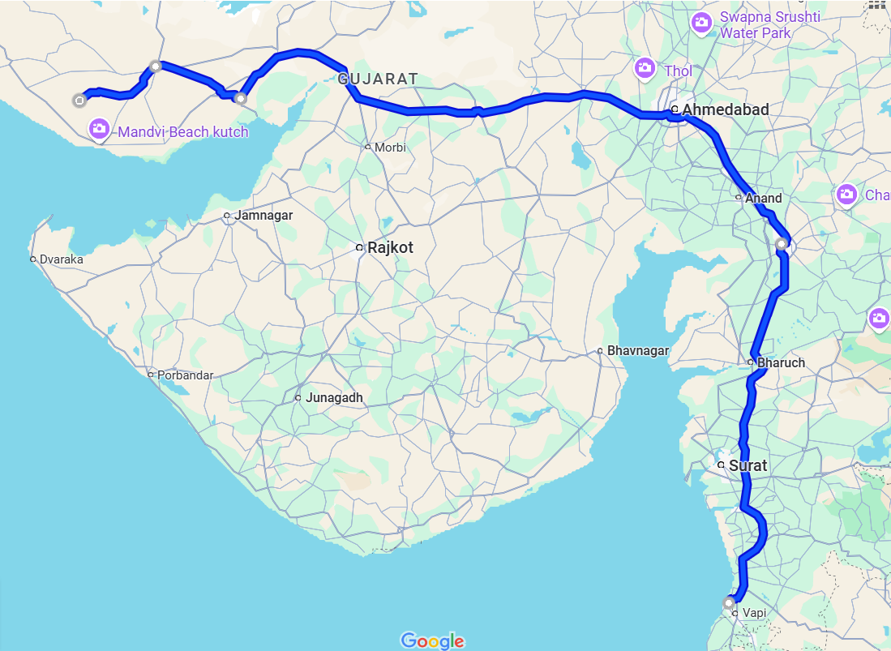
10. Logistics and Transformation
754k
3
Location: Poladia, Gujarat, India
Why Suzlon company wind turbine?
Manufacturing in Gujarat
Government provides incentives (Made in India)
4
NH27
NH64
NE1
2
NH4
Wind Turbine Manufacturing components | Manufacturing Locations | Distance between Manufacturing location to Wind farm [km]
Nacelle | Daman, Gujarat, India | 743
Nacelle Cover | Daman, Gujarat, India | 743
Hub | Daman, Gujarat, India | 743
Rotor Blades | Bhuj, Gujarat, India | 57
Tower | Gandhidham, Gujarat, India | 136
Electrical | Vadodara, India | 544
NH48
1

Slide 21
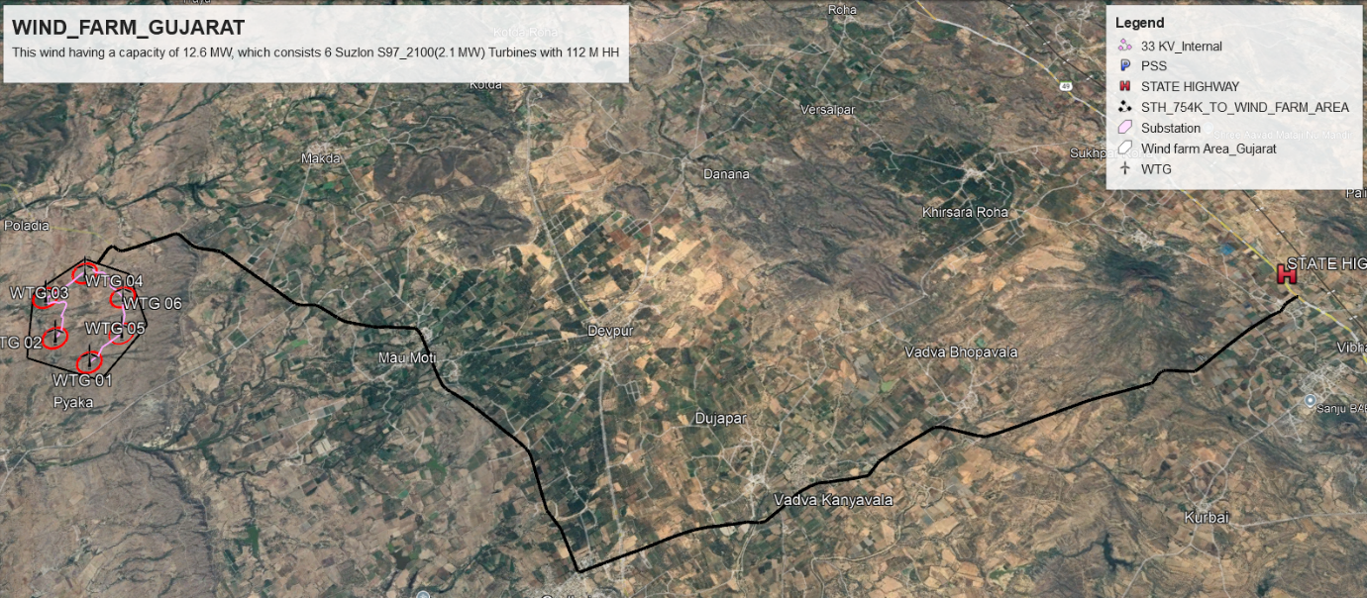
10. Logistics and Transformation
Distance Between State highway to Wind Farm: 25 km

Slide 22
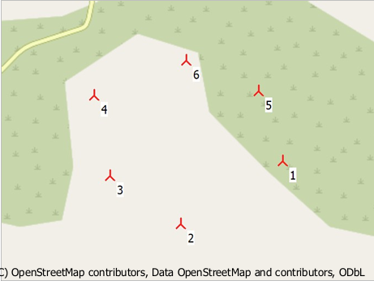
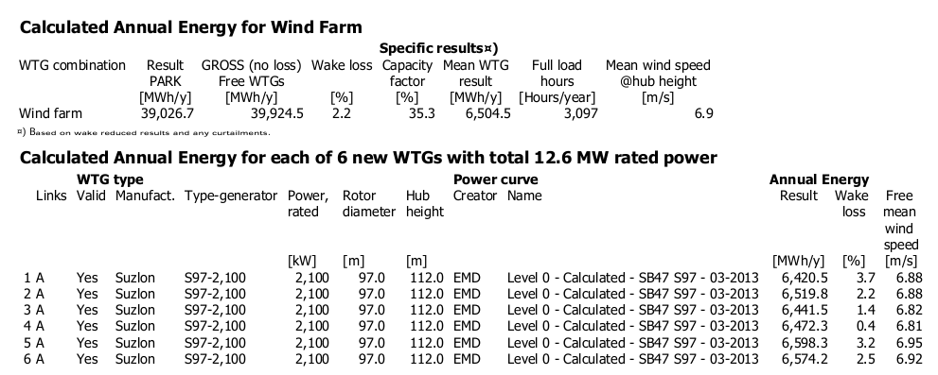
11. Profitability Analysis
Input Parameters to calculate Profit analysis calculation:

Slide 23
11. Profitability Analysis
Input Parameters to calculate Profit analysis calculation:
Parameter | Economics | Unit
Number of WT | 6 | -
Installation output | 2100 | KW
Total output | 12600 | kW
Gross Energy Yield | 39026700 | KWh/a
Total losses | 2.20 | %
Net Energy Yield | 3,81,68,113 | kWh
Site Quality | 71.04 | %
Feed in Tariff | 0.033 | Euro/kWh
Total Investment Costs | 98,07,253 | Euro
Total Operating Costs | 1,05,000 | Euro
Constant Payment Loan Type (Debt ratio) | 72.73 | %
Equity | 26,74,327 | Euro
Term | 17 | Years
Interest rate of Bank | 9.0 | %
Debt Capital | 71,32,926 | Euro
Inflation rate | 5.16 | %

Slide 24
11. Profitability Analysis

Slide 25
11. Profitability Analysis

Slide 26
11. Profitability Analysis

Slide 27
12. Results
 | Value | Unit
NPV | 58,192 | EUR
NPV costs | 25,42,246 | EUR
NPV kWh | 39,56,79,974 | EUR
IRR | 7.557 | %
LEC | 0.0184 | EUR
Min. DSCR | 1.08
ADSCR | 1.38
Positive NPV
Impressive IRR
Project promises cost efficiency and financial stability
Highly profitable project
NPV = Net Present Value, IRR = Internal Rate of Return, LEC = Levelized Cost of Energy, Min. DSCR = Minimum Debt Service Coverage Ratio, ADSCR = Average Debt Service Coverage Ratio

Slide 28
13. Long Term Strategy
Vision and Goals:
By 2030:
Achieve an installed wind energy capacity of 15 GW.
Increase the share of wind energy to 20% of the state's total energy mix.
Launch the first phase of offshore wind projects.
By 2050:
Establish Gujarat as a global leader in wind energy.
Fully integrate smart grid solutions for efficient energy distribution.
Achieve a 50% reduction in carbon emissions from energy production.
Strategy to achieve goal:
Improve Policy support
Advanced turbine technologies
Upgrade infrastructure
Integrating smart grid
Encouraging community engagement
Spend more money in research and development of wind turbine
Energy storage system

Slide 29
14. Barriers and Obstacles
High Initial Costs
Standardization and Quality Control
Maintenance Issues
Land Use Conflicts
Limited Awareness
Grid Integration
Environmental Concerns
Preference for Solar Energy

Slide 30
15. Conclusion
Location of Wind farm Perspective:
Taking advantage of Gujarat favourable policy environment
Manufacturing location of Suzlon company
Economic Perspective:
Reducing carbon emissions
Job creation
Local manufacturing
Suggestions:
Increasing capital investment
Raising energy prices or seeking government support for loans
Project faces significant challenges:
high bank tax rates
low energy prices
which reduce its overall profitability.
Profit Perspective:
Project Achieves a positive NPV
Impressive IRR

Slide 31
16. References

